Slide 1
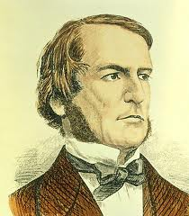
Boolean Logic
Logic Gates
Boolean Algebra
Transistor Switches
Logic Gates
Digital Circuits
Computer Architecture
Transistor Switches
Devised a system of logic using True or False variables for determining the truth of a statement.
Laid the foundations for the digital revolution and paved the way for the computer age.
Boolean algebra is a type of mathematical operation that, unlike regular algebra, works with binary digits (bits): 0 and 1. While 1 represents true, 0 represents false.
George Boole (1815-1864)
19th c.
1854
20th c.
21st c.
[# 15 Bootcamp] <Academia de código>
1

Slide 2
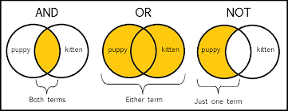
Boolean Logic
Logic Gates
Boolean Algebra
Transistor Switches
Logic Gates
Digital Circuits
Computer Architecture
Transistor Switches
The basic logical operators are: AND , OR and NOT
Source: google
These mathematical operations have two possible results/ values:
TRUE/ FALSE ; ON/ OFF; 1/ 0
George Boole (1815-1864)
19th c.
1854
20th c.
21st c.
[# 15 Bootcamp] <Academia de código>
2

Slide 3
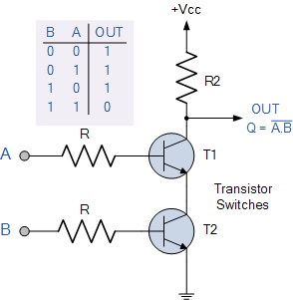
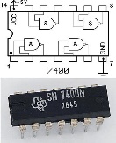
Boolean Algebra
Boolean Logic
Logic Gates
Transistor Switches
Logic Gates
Digital Circuits
Computer Architecture
Transistor Switches
Two transistors and a digital logic gate with two or more inputs and one output with a behavior that is the opposite of an AND gate – Negated AND gate – will create an electronic circuit to do Boolean operations.
A NAND gate consists of one or more inputs with a single output. The output of the NAND gate always remains true if at least one of its inputs remains false.
Truth table for a NAND gate
Input A | Input B | Output
False/ 0 | False/ 0 | True/ 1
False/ 0 | True/ 1 | True/ 1
True/ 1 | False/ 0 | True/ 1
True/ 1 | True/ 1 | False/ 0
NOTE:
Transistor – a switch, lets or not pass an electric current.
Integrated circuits – chips or microchips; allow electric circuits in extremely tinny dimensions.
19th c.
20th c.
21st c.
[# 15 Bootcamp] <Academia de código>
3

Slide 4
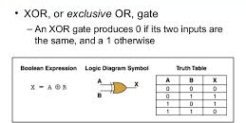
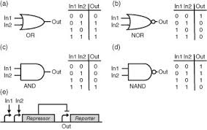
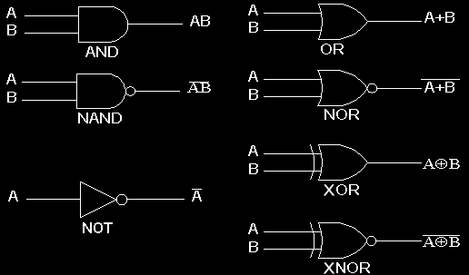
Boolean Algebra
Boolean Logic
Transistor Switches
Logic Gates
Digital Circuits
Computer Architecture
Logic Gates, are the logical constructs, the building blocks, that make up the framework for path generation in computer processing.
19th c.
20th c.
21st c.
[# 15 Bootcamp] <Academia de código>
4

Slide 5
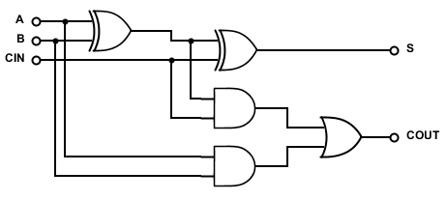
Boolean Algebra
Boolean Logic
Transistor Switches
Logic Gates
Digital Circuits
Computer Architecture
A NAND gate allow us to make all the other logic gates seen before.
1 bit adder circuit => to have 4 bits = 4 x 1 bit adder
19th c.
20th c.
21st c.
[# 15 Bootcamp] <Academia de código>
5

Slide 6

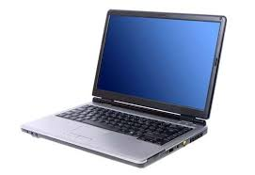
Boolean Algebra
Boolean Logic
Transistor Switches
Logic Gates
Digital Circuits
Computer Architecture
A Computer, is an electronic device made of digital circuits: inputs – instructions/ program, data, and outputs – result of the operations done with the inputs.
Stores and processes data cording to the instructions given by a program stored in the memory
So, it is re-programmable
Source: google
19th c.
20th c.
21st c.
[# 15 Bootcamp] <Academia de código>
6

Slide 7
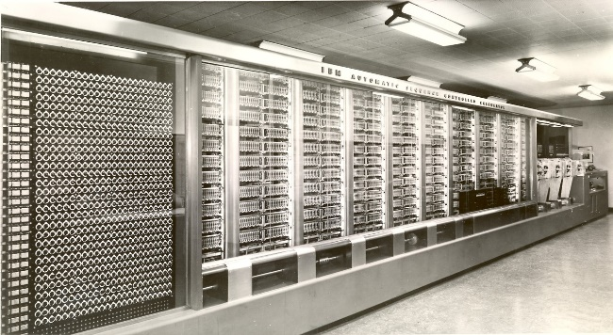
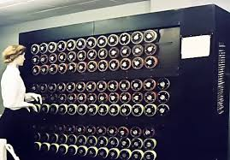
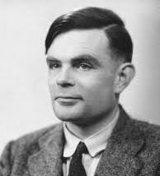
Electromechanical Computers
Von Neumann Architecture
Computer Bus
Memory Subsystem
Memory Organization
Memory Architecture
Random access Memory
Read Only Memory
ASCII
Created the basic principles of computer science: control the machine's operations by means of a program of coded instructions stored in the computer memory.
‘Bombe’, was created to ciphering and deciphering secret messages during World War II – It was an electromechanical computer because it changed circuits by someone moving cables in plugboards.
MARK I (IBM ASCC) was also an electromechanical computer: switches were opened and closed by magnetic fields produced by relays. Instructions and data via two separated punched paper tapes.
Source: google
Alan Turing (1912-1954)
19th c.
20th c.
1939
21st c.
[# 15 Bootcamp] <Academia de código>
7

Slide 8
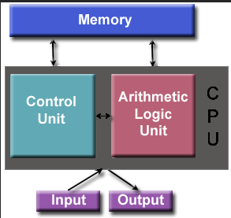
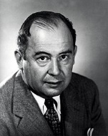
Electromechanical computers
Von Neumann Architecture
Computer Bus
Memory Subsystem
Memory Organization
Memory Architecture
Random access Memory
Read Only Memory
ASCII
Created the basic principle of modern computers: program and data both stored in the same memory.
CU – executes program instructions sequentially.
ALU – Does all the data calculations
All units are interconnected through ‘Computer Bus’.
Von Neumann (1903-1957)
19th c.
20th c.
1944
21st c.
[# 15 Bootcamp] <Academia de código>
8

Slide 9
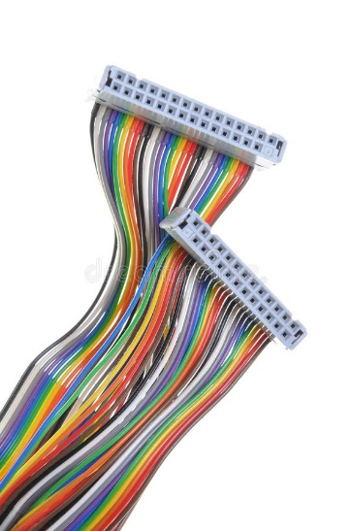
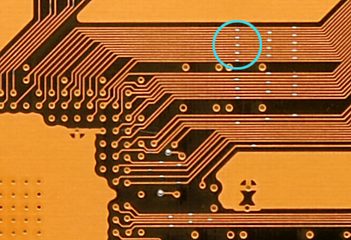
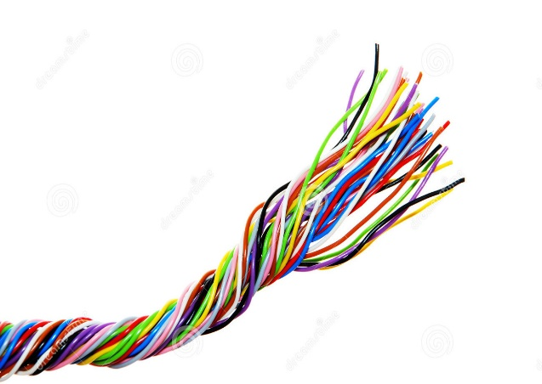
Electromechanical computers
Von Neumann Architecture
Computer Bus
Memory Subsystem
Memory Organization
Memory Architecture
Random access Memory
Read Only Memory
ASCII
Is a set of physical connections which can be shared by multiple hardware components in order to communicate with one another.
19th c.
20th c.
21st c.
[# 15 Bootcamp] <Academia de código>
9

Slide 10
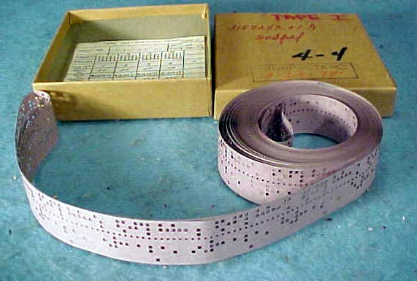
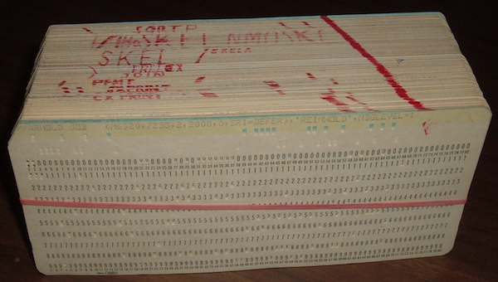
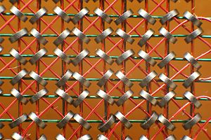
Electromechanical computers
Von Neumann Architecture
Computer Bus
Memory Subsystem
Memory Organization
Memory Architecture
Random access Memory
Read Only Memory
ASCII
Several memory subsystems were used in the past:
Today, memories with logic gates are used to store 1 bit of information and are called Flip-flops.
Flip-flops have only two states: store or not store – 1 or 0
19th c.
20th c.
21st c.
[# 15 Bootcamp] <Academia de código>
10

Slide 11
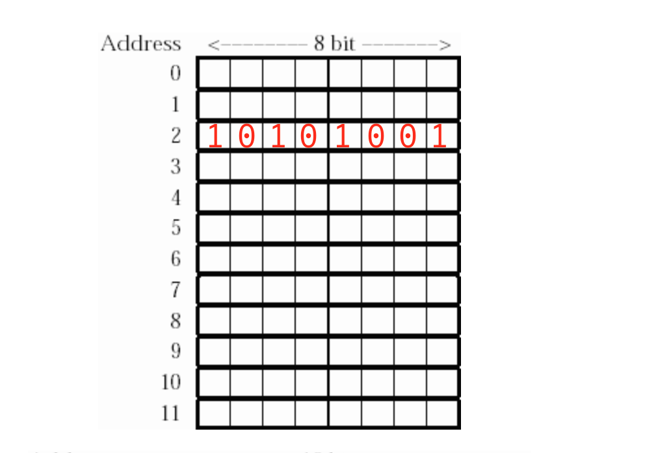
Electromechanical computers
Von Neumann Architecture
Computer Bus
Memory Subsystem
Memory Organization
Memory Architecture
Random access Memory
Read Only Memory
ASCII
Main memory: is organized in a matrix of bits, where each row represents a location in memory . It is multi-bit in length (8, 16, 32 or 64 bits)
256 possible patterns
19th c.
20th c.
21st c.
[# 15 Bootcamp] <Academia de código>
11

Slide 12
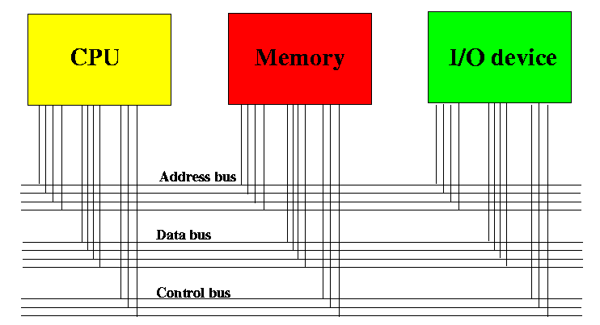
Electromechanical computers
Von Neumann Architecture
Computer Bus
Memory Subsystem
Memory Organization
Memory Architecture
Random access Memory
Read Only Memory
ASCII
Address Bus: carries the address of a memory cell.
Data Bus: to transfer data to and from a memory cell.
Control Bus: selects read or write operations between memory and cpu or Input/Output devices.
I/ O - provide a way to interact with computer hardware.
19th c.
20th c.
21st c.
[# 15 Bootcamp] <Academia de código>
12

Slide 13
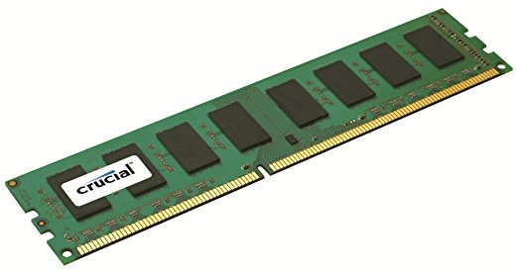
Electromechanical computers
Von Neumann Architecture
Computer Bus
Memory Subsystem
Memory Organization
Memory Architecture
Random access Memory
Read Only Memory
ASCII
Characteristics of RAM:
Has several memory cells off fixed size.
The access to the memory always takes the same time independently of it’s cell address - it is constant.
All memory content is lost if power fails.
19th c.
20th c.
21st c.
[# 15 Bootcamp] <Academia de código>
13

Slide 14
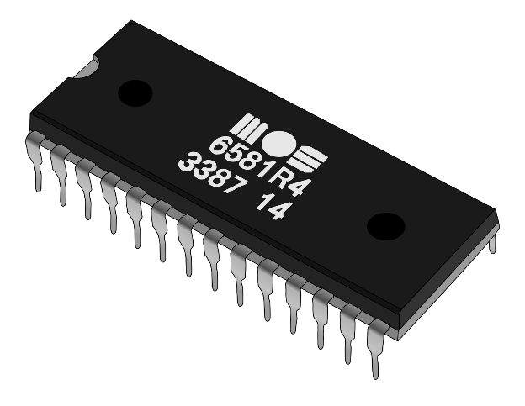
Electromechanical computers
Von Neumann Architecture
Computer Bus
Memory Subsystem
Memory Organization
Memory Architecture
Random access Memory
Read Only Memory
ASCII
Characteristics of ROM:
It can not be re-programmable. Contents are written during production faze.
It can only be read.
Memory content is not lost if power fails.
As it is a very small memory it is the fastest one.
19th c.
20th c.
21st c.
[# 15 Bootcamp] <Academia de código>
14

Slide 15
Electromechanical computers
Von Neumann Architecture
Computer Bus
Memory Subsystem
Memory Organization
Memory Architecture
Random access Memory
Read Only Memory
ASCII
Is a character encoding scheme, none as American Standard Code for Information.
Is based in the English language and uses a table that relates characters with binary language, using only 7 bits – a total of 128 characters.
This encoding scheme was surpassed by UTF-8 after 2008 – an Unicode, which uses 8 bites.
19th c.
20th c.
21st c.
[# 15 Bootcamp] <Academia de código>
15

